Slide 1

Binary Adder/Subtractor

Slide 2
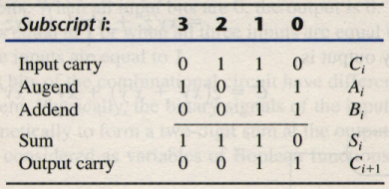
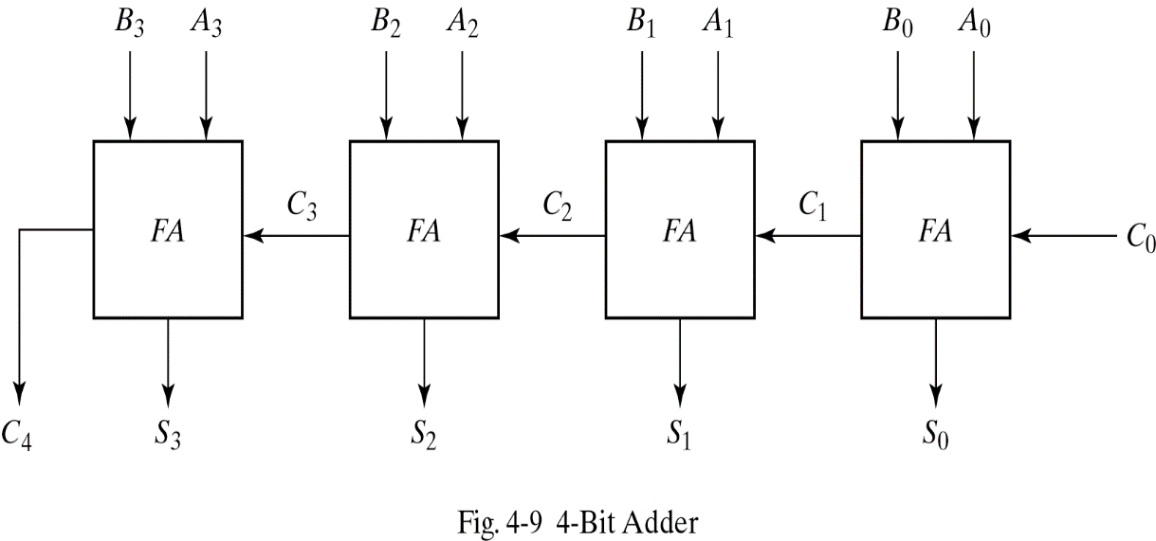
4-bit Binary Adder
This is also called Ripple Carry Adder ,
because of the construction with full adders
are connected in cascade.
4-bit Binary Adder

Slide 3
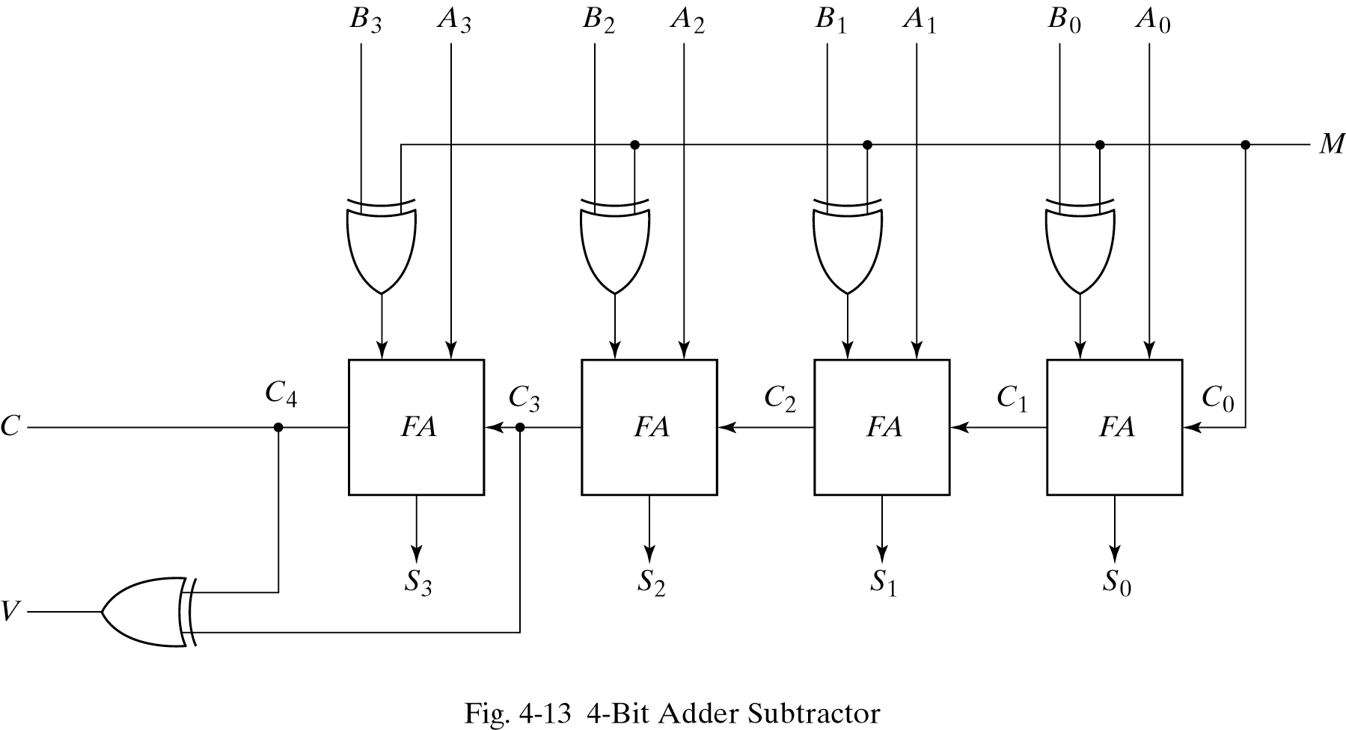
4-bit BinaryAdder/Subtractor with overflow
M = 1→subtractor ; M = 0→adder

Slide 4
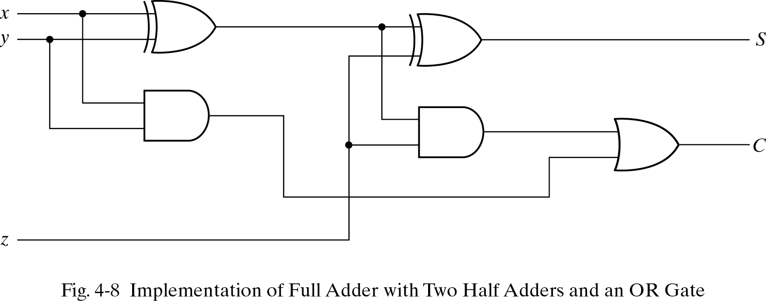
Full adder using half adder
Full-adder can also implemented with two half adders and one OR gate.
S = z ⊕ (x ⊕ y)
= z’(xy’ + x’y) + z(xy’ + x’y)’
= xy’z’ + x’yz’ + xyz + x’y’z
C = z(xy’ + x’y) + xy = xy’z + x’yz + xy

Slide 5
Boolean functions for Carry look ahead adder
P_{i} = A_{i} ⊕ B_{i} steady state value
G_{i} = A_{i}B_{i} steady state value
Output sum and carry
S_{i} = P_{i} ⊕ C_{i}
C_{i+1} = G_{i} + P_{i}C_{i}
G_{i} : carry generate P_{i} : carry propagate
C₀ = input carry
C₁ = G₀ + P₀C₀
C₂ = G₁ + P₁C₁ = G₁ + P₁G₀ + P₁P₀C₀
C₃ = G₂ + P₂C₂ = G₂ + P₂G₁ + P₂P₁G₀ + P₂P₁P₀C₀
C₃ does not have to wait for C₂ and C₁ to propagate.

Slide 6
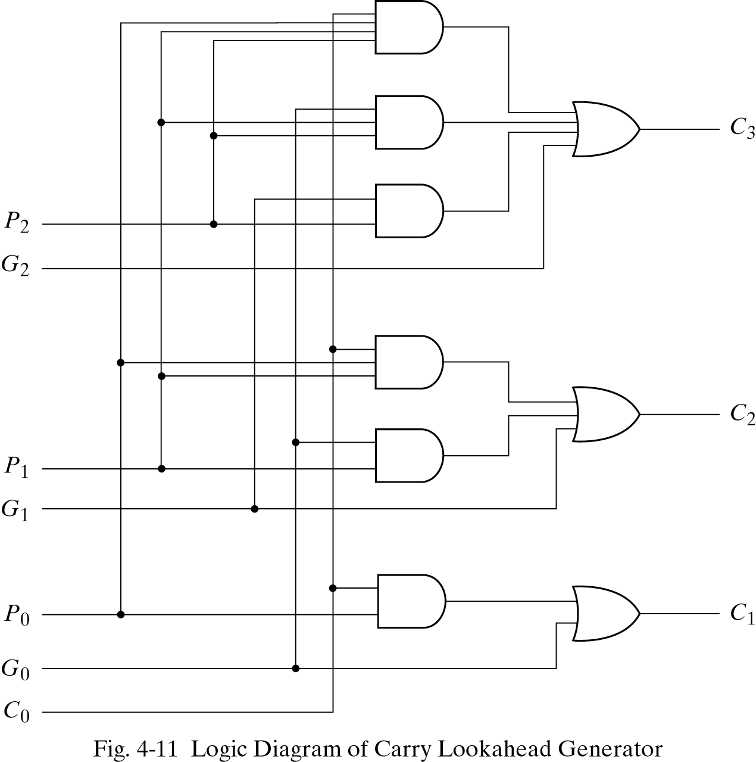
Logic diagram of carry look-ahead generator
C₃ is propagated at the same time as C₂ and C₁.

Slide 7
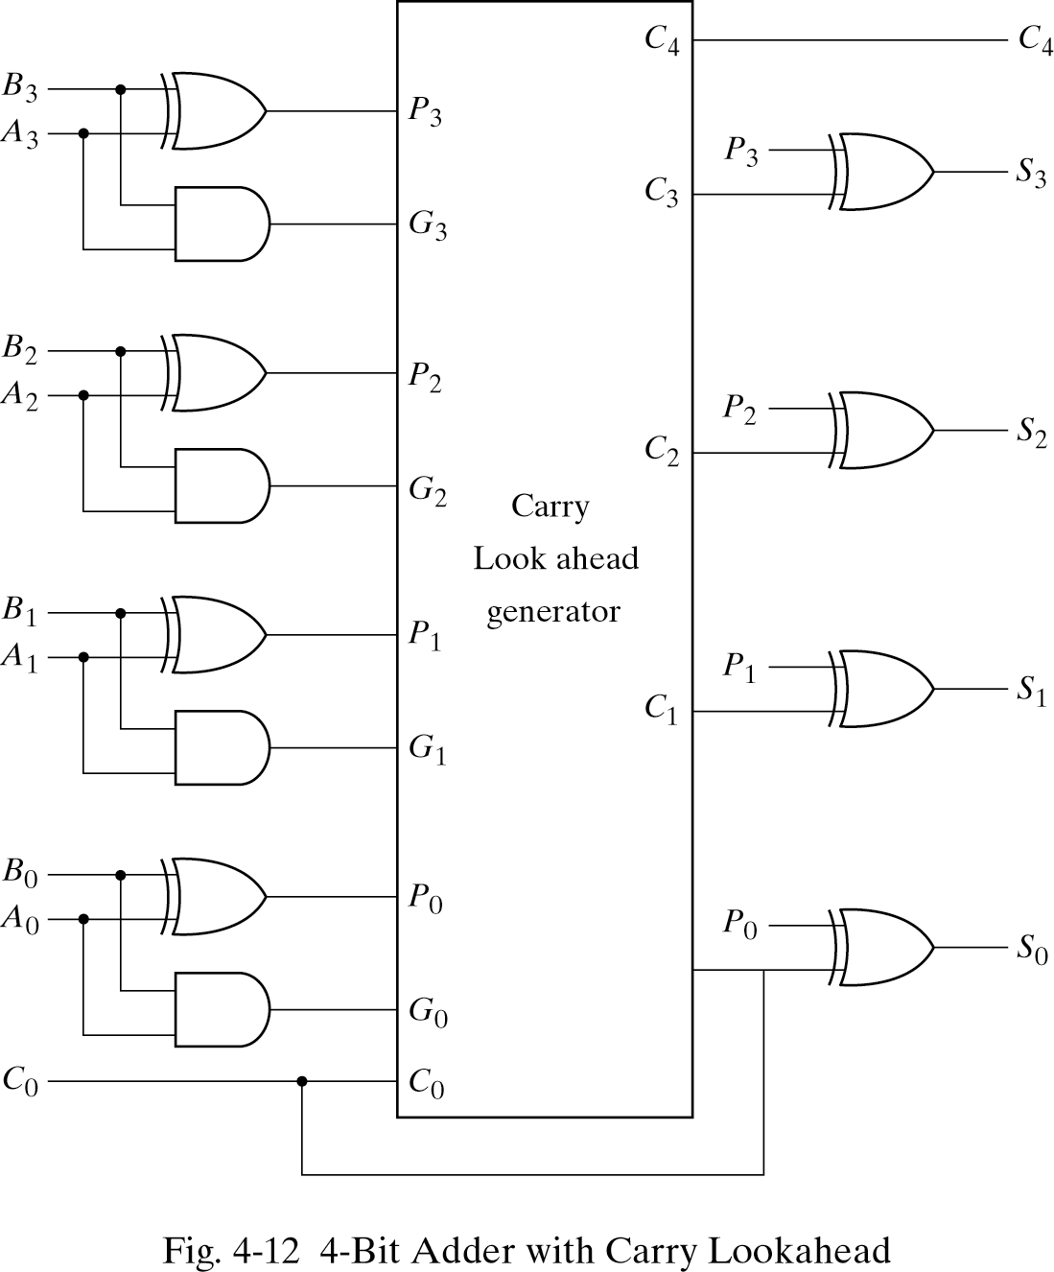
4-bit adder with carry look ahead
Delay time of n-bit CLAA = XOR + (AND + OR) + XOR

Slide 8
Thank You

